Slide 1
Facilities Planning
LAYOUT

Slide 2
What is Facility Planning?
Facility planning exercise determines how an activity’s tangible fixed assets best support achieving the activity’s objectives.
In developing a layout for a system producing goods or services organisations seek to determine the best arrangement of facilities and equipment capable of satisfying anticipated demand at lowest cost.
Facility planning is also know as layout planning, plant layout, facilities design.

Slide 3
Consequences of Poor Layout
Congestion in aisles and storage areas and poor utilisation of space
Excessive in process inventory and excessive work flow distances
Continual production bottlenecks in some locations and simultaneous idle facilities elsewhere
Skilled workers doing excessive unskilled work
Long operation cycles and delivery delays
Worker anxiety and strain
Accidents or near accidents
Obvious lack of production control

Slide 4
Need for Facility Planning
Effective facilities planning:
can reduce the cost of material handling.
enables changes or adjustment to be made to the existing layout as a result of changes in demand and technology
provides easy access to equipment maintenance and repairs thus reducing downtimes and maintenance cost
minimizes losses in both money and manpower resulting from accident
provides a working environment that leads to a better utilization of human resources in the organization

Slide 5
Purposes of Re-layout
To maximise the profitability or efficiency of operations
Minimise safety or health hazards
Freeing up bottleneck operations and
Minimising interference, noise or distractions between different operational areas

Slide 6
Types of Layout
Process Layout
Product Layout
Fixed Position Layout
Cellular Layout
Retail/Service Layout
Warehouse Layout
Office

Slide 7
Process Layout
A process layout is the arrangement of facilities and equipments in groups according to function performed or in departments.
Milling
Department
Lathe Department
Drilling Department
M
M
D
D
D
D
L
L
M
M
D
D
D
D
L
L
L
L
G
G
G
P
G
G
G
P
L
L
Grinding
Department
Painting Department
L
L
A
A
A
Receiving and
Shipping
Assembly

Slide 8
Advantages of Process Layout
Flexibility in equipment and labor assignment
Manufacture of parts in small batches or job lots and the production of a wide variety of parts in different sizes or forms.
Greater incentive for groups of workers to raise level of performance and greater possibility of group incentives.

Slide 9
Disadvantages of Process Layout
Orders take more time and money to move through the system because of difficulty of scheduling, setups and material handling
Higher total material handling cost
Labor skill requirements are higher and this increases the required levels of training and experience
Work-in-process inventories are higher because of higher imbalances in the production process

Slide 10
Product layout
Is an arrangement of facilities and equipment in the same sequence as that of the operations needed to complete each unit of the product or the service offered.
The production line is typically automated and the uses such means as conveyors through a series of workstations.
In
Out

Slide 11
Advantages of Product Layout
Less duplication of equipment and hence lower total investment in equipment and training
Low variable cost per unit because of high volume and standardized products
Material handling costs are low
Work-in-process inventories are also kept low
Better and more efficient supervision possible through specialization
Greater incentive to efficient individual workers

Slide 12
Disadvantages of Product Layout
High volume is required because of high investment needed to set up the process
Work stoppage at any one point ties up the whole operation
Less flexibility of production

Slide 13
Comparison of Product and Process Layouts
Product
Process
Description
Type of process
Product
Demand
Volume
Equipment
Sequential arrangement of activities
Continuous, mass production, mainly assembly
Standardized, made to stock
Stable
High
Special purpose
Functional grouping of activities
Intermittent, job shop, batch production, mainly fabrication
Varied, made to order
Fluctuating
Low
General purpose

Slide 14
Comparison of Product and Process Layouts
Product
Process
Workers
Inventory
Storage space
Material handling
Aisles
Scheduling
Layout decision
Goal
Advantage
Limited skills
Low in-process, high finished goods
Small
Fixed path (conveyor)
Narrow
Part of balancing
Line balancing
Equalize work at each station
Efficiency
Varied skills
High in-process, low finished goods
Large
Variable path (forklift)
Wide
Dynamic
Machine location
Minimize material handling cost
Flexibility

Slide 15
Developing the Process Layout
Analyse the product or products to be produced
Complete design drawings
The parts list which established those parts to be manufactured and/or purchased and which must be provided for the general plant area under consideration
Assembly charts indication the sequence by which the parts are combined into assemblies

Slide 16
Developing the Process Layout(cont.)
2.Determine the process required to manufacture the product
Route sheets and operations sheets must be obtained or developed for each manufactured part or assembly
Operation process charts are prepared following the preparation of the route sheets to provide a means of combining the assembly charts and route sheet data in a single form
3. Prepare layout planning chart which includes:
Flow process showing all operations, moves, storages and inspections
Standard times for each operation obtained from time study or pre-determined standards

Slide 17
Developing Process Layout(cont)
Machine selection
Manpower requirements for the production activity
Machine balance and manpower balance
Material handling load, methods and equipment requirements
4. Determine the work stations
Layout must be developed taking into consideration machine, operator, materials and service area requirement

Slide 18
Developing the process layout(contd)
5. Analyse storage area requirement
6. Establish minimum aisle widths
7. Establish office requirements
8. Consider personnel facilities and services
9. Survey plant services
10. Provide for further expansion

Slide 19
Conventional Approach for Developing Product Layout
Product layouts are suitable for mass production of discrete items
Products layout are used to achieve smooth flow of large volume of highly standardised products that require repetitive processing operations
The main issue in design of product layout is line balancing
The process of deciding how to assign tasks to work stations on the line is referred to as line balancing
The objective of line balancing is to obtain task groupings that represent approximately equal time requirement.

Slide 20
Conventional Approach for Developing Product Layout(cont)
Perfect balance would lead to smooth flow of work
It is difficult to achieve perfect balancing as a result of inability to obtain task groupings that have same durations
The cycle time which is the amount of time each work station has to complete its set of task before the product moves to the next station, determines the output rate per line.

Slide 21
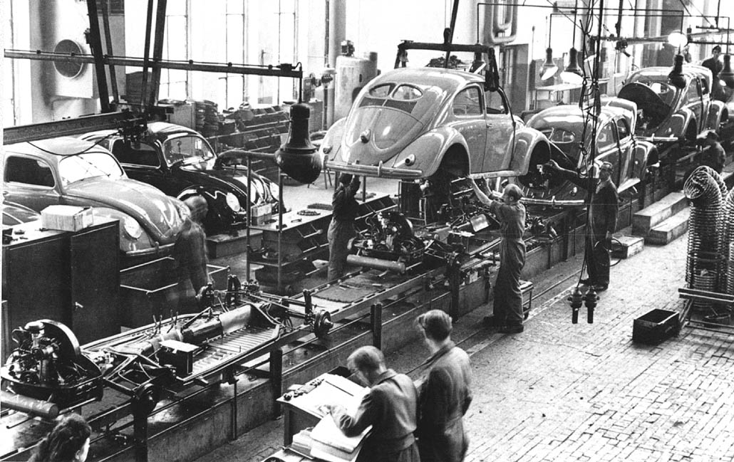
Assembly Line

Slide 22
Assembly Line
An assembly line is a manufacturing process (most of the time called a progressive assembly) in which parts are added to a product in a sequential manner to create a finished product.
It is much faster way of producing a product.
Assembly lines work on the principle of division of labour propounded by Adam Smith.
- Break the production process of product into elemental task
Group tasks together
Set up the workers, tools or machines, and parts in a sequential order
-Each worker typically performs one simple operation.
-The motion of workers is minimized to the extent possible.
All parts or assemblies are transported through different work centers using either conveyors or motorized vehicles

Slide 23
Typical Delay Scenarios
Flow-blocking delay: Work-in-progress cannot be released because the following workstations is occupied
Lack of work delay: Work has been completed at one station but new job has not arrived.
These are indications of an unbalanced line.
The assembly line technique builds on the operations chart and the plant rate.
The objective is to give each operator as close to the same amount of work as possible.
This can only be done by breaking the work into basic motions to do every single piece of work and reassembling into jobs of near equal time value.

Slide 24
Assembly Line Balancing
The technique of ensuring that each workstation is has a near equal time is what is known as assembly line balancing.
Purpose:
Equalise workload among the assemblers
Identify bottleneck operations
Establish the speed of the assembly line
Determine the number of work stations
Determine the labour cost of assembly and packout
Establish the percentage workload of each operator
Assist in plant layout
Reduce production cost

Slide 25
Assembly Line Balancing
Cycle time: that is the time each product is available at each workstation
Cycle time =Production time available per day
Demand per day
Cycle time(d) =Production time available per day
Production rate per day
Theoretical minimum number of workstations =Summation of time at each workstation
Cycle time
Efficiency of the line = Summation of time at each workstation
Actual number of workstation * Cycle time

Slide 26
Assembly Line Balancing: An Example
Work Element | Precedence Relationship | Time (Min)
A | - | 4
B | A | 2
C | A | 1
D | B | 1
E | B | 5
F | D | 3
G | CEF | 4
The Production Manager is tasked to produce 120 units of the product in a 10hr a day total available production time.
1. Determine the theoretical minimum number of workstations?
2. What is the actual number of workstations?
3. What is the efficiency of the line?

Slide 27
Assembly Line Balancing: An Example
D
F
B
A
E
C
G
Cycle time = 10 * 60
120
= 5 minutes
Theoretical minimum number of workstations is =4+2+1+1+5+3+4 = 20 = 4
5 5

Slide 28
Assembly Line Balancing: An Example
Rule of thumb: Always assign the longest time task first
Work station 1
Work station 2
Task | Time used | Time remaining
A | 4 | 1
C | 1 | 0
Task | Time used | Time remaining
B | 2 | 3
D | 1 | 2
Work station 3
Task | Time used | Time remaining
E | 5 | 0
Work station 4
Task | Time used | Time remaining
F | 3 | 2
Work station 5
Efficiency of the line = Summation of time at each workstation
Actual number of workstation * Cycle time
Task | Time used | Time remaining
G | 4 | 1
= 20 = 80%
5*5

Slide 29
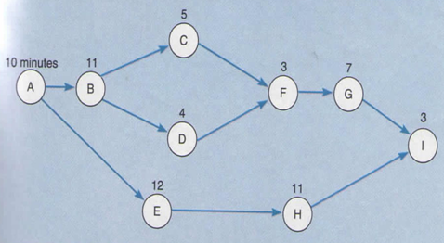
Assembly Line Balancing: Example 2
Assume daily production quantity of 122
and a 10 hour available production time.
What is the cycle time
What is the theoretical minimum number of work stations?
What is the actual number of work stations?
What is the efficiency of the assembly line?

Slide 30
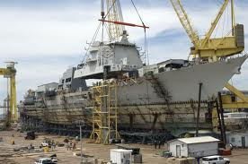
Fixed-Position Layouts
Typical of projects in which product produced is too fragile, bulky, or heavy to move
Equipment, workers, materials, other resources brought to the site
Low equipment utilization
Highly skilled labor
Typically low fixed cost
Often high variable costs

Slide 31
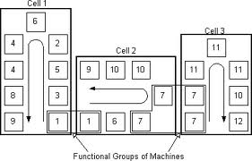
Cellular Layout

Slide 32
Material Handling
Material handling: the movement, storage, control and protection of materials, goods and products throughout the process of manufacturing, distribution, consumption and disposal
Objectives of Material Handling
Increase capacity
Improve working condition
Improved customer service
Increased equipment and space utilisation
Reduced cost

Slide 33
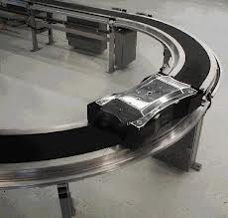
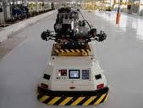
Automatic Material Handling System
Conveyor
AGV

Slide 34
Material Handling: Assignment
Define what a material handling systems is.
What are the main categories of material handling systems?
Identify two material handing systems, belonging to different categories and write about them:
Name, application and uses,
Parts,
Operation
Pictures and diagrams
Total 10 marks
Deadline for submission 19th of March, 2013

